Slide 1

QTM 530: Introduction to Web Scraping

Slide 2
What is web scraping?
Web scraping refers to the process of systematically extracting information from websites using automated code.

Slide 3
Types of Web Scraping
API (Application Programming Interface)
Protocol for users to retrieve information via web-based requests
Explicitly developed by the owner of the data to make the information available to others in an easy format
Structured output
Can be free (often with a cap on use) or subscription based
Internal company (password protected) or public domain.

Slide 4
Types of Web Scraping
2. Web Crawling
An automated algorithm designed to extract information from websites
Not explicitly developed by owner of data. The developer of the web crawler browses existing online data.
Unstructured data in a variety of web-based programming.
Often requires designing interactive coding, to click through different pages, or extract relevant information.

Slide 5
Benefits of Web Scraping
Data construction: New information available online.
Data updating: Periodically pull new information.
App development: Business application using external information, e.g. geolocation.
Automation: Repeat tasks that might otherwise be done manually.
Python has a very sophisticated set of tools for handling web scraping tasks!

Slide 6
Challenges of Web Scraping
Complexity: Websites often have a complex structure and processing requires advanced data wrangling.
Interactivity: Some websites require user interaction to obtain data and this needed to be coded.
Multiple Environments: Scraping requires knowledge of different types of languages Python, HTML, JSON, depending on the format of the dataset.
Scaling: Automating the process and making it fast requires knowledge of flow control and parallel computing.
We’ll teach you all these skills!

Slide 7
Ethical Issues
Be mindful of user’s right to privacy and be careful to abide by existing legal frameworks.
Some websites explicitly prohibit web scraping in their terms of service. Gather information about a website’s existing policies before beginning a web-scraping task.
This may include restrictions on how the information can be extracted, stored in an external repository, and or resold to third parties.
It may also include conditions on whether information can be used for personal and/or commercial purposes.
Be mindful of not disrupting a website’s normal operation through too many requests. Some websites may restrict web access.
Websites may include ads that advertisers pay for, and creating artificial bots that click through these ads can generate unethical disruptions in a business’ operations.

Slide 8
Part I: JSON Formatting and Extracting Data via APIs

Slide 9
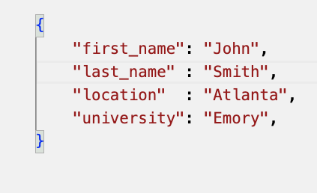
JSON Format
JSON stands for Java Script Object Notation
Frequently used in web-based programming
Relies on key-value pairs, e.g. “first_name” and “John”, respectively.
Definition starts with curly brackes, assignment with colon, elements separated by a comma.

Slide 10
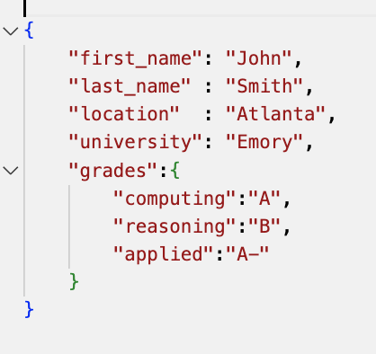
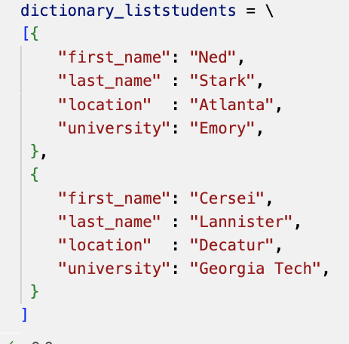
Nested JSON and Lists
An object may have multiple associated values.
This can be represented via nested structures and/or lists
Lists are denoted with square brackets, can be used for different records
JSON objects have a “tree”-like, branched structure.

Slide 11

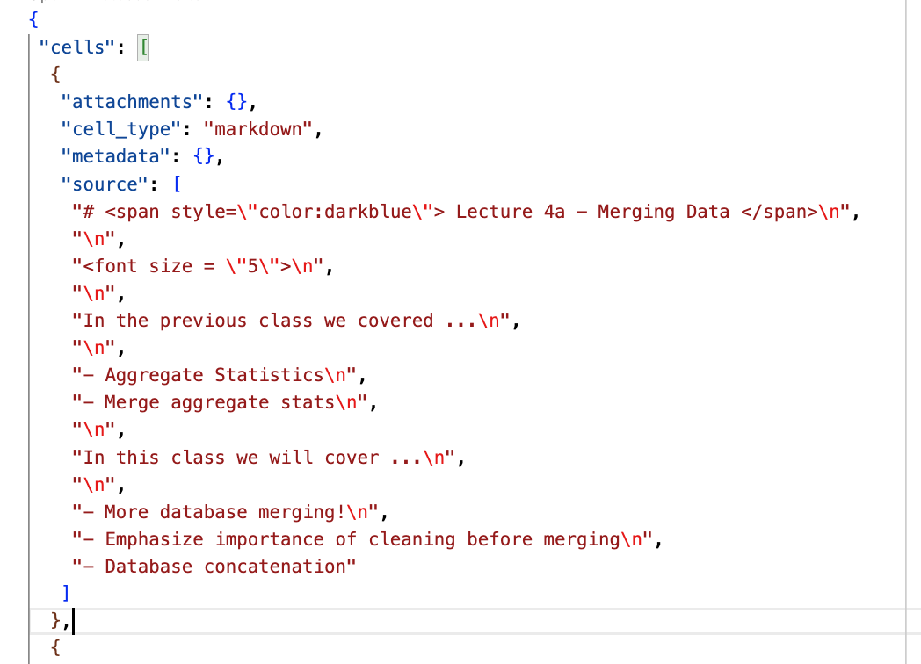
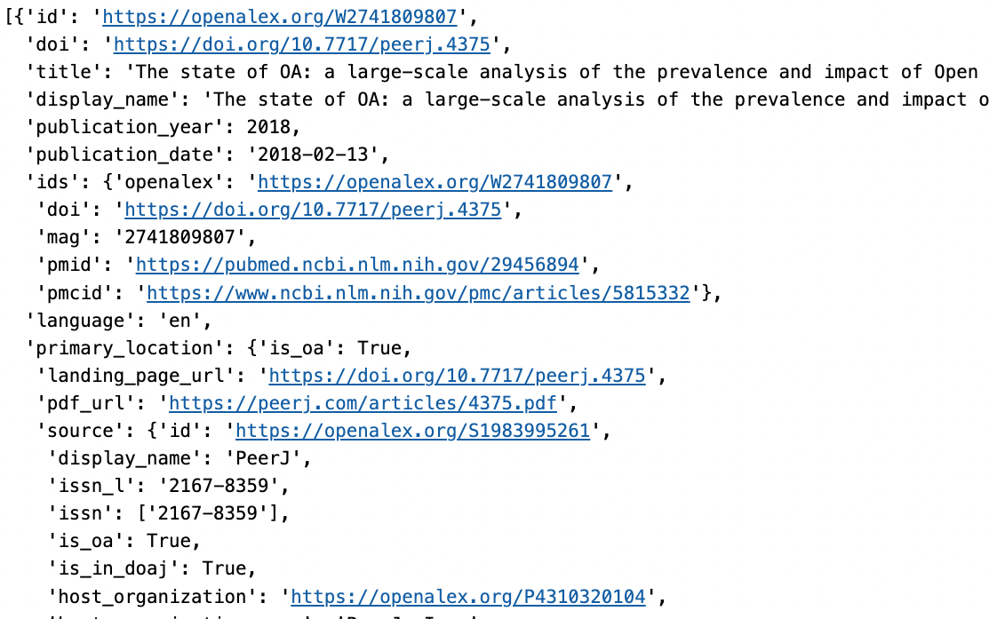
Three Examples of JSON Formats
Python dictionaries
Jupyter notebooks raw code
Output from APIs

Slide 12
Self-Directed Portion: Lecture 5 Python Notebook

Slide 13
Part II: Introduction to HTML

Slide 14
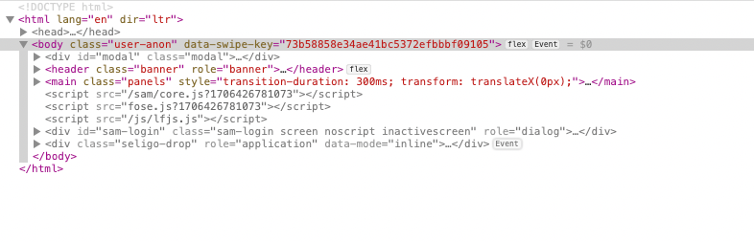
HTML
HTML stands for HyperText Markup Language
HTML uses a nested structure with the different components
Components start with <html> and ends with </html>
Different tags <header>, <body>, <div> signal different parts of
<div> is a common tag

Slide 15
HTML Tags
HTML components include tags, e.g. “class”, “role”, etc. that can be used to identify and extract objects.

Slide 16
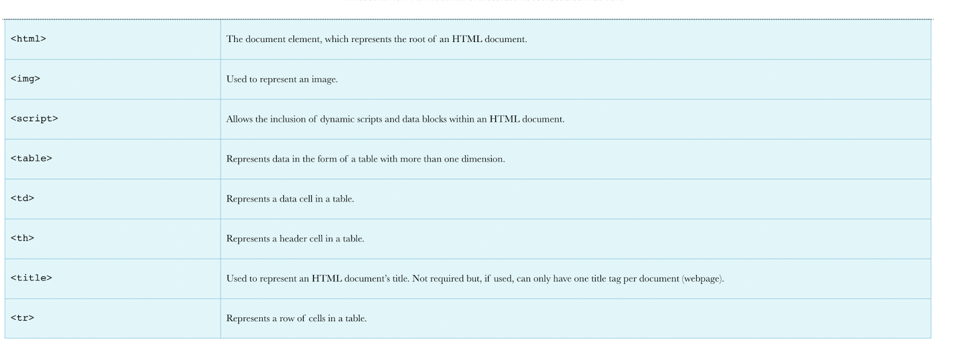
Types of HTML Components
Source: Kaefer, Frederick, and Paul Kaefer. Introduction to Python Programming for Business and Social Science Applications. SAGE Publications, 2020, Chapter 7.

Slide 17
In-class Example of Developer Mode

